Slide 1
VAPOR AND COMBINED POWER CYCLES

Slide 2
Objectives
Evaluate the performance of gas power cycles for which the working fluid remains a gas throughout the entire cycle.
Analyze vapor power cycles in which the working fluid is alternately vaporized and condensed.
Analyze power generation coupled with process heating called cogeneration.
Investigate ways to modify the basic Rankine vapor power cycle to increase the cycle thermal efficiency.
Analyze the reheat and regenerative vapor power cycles.
Analyze power cycles that consist of two separate cycles known as combined cycles.

Slide 3

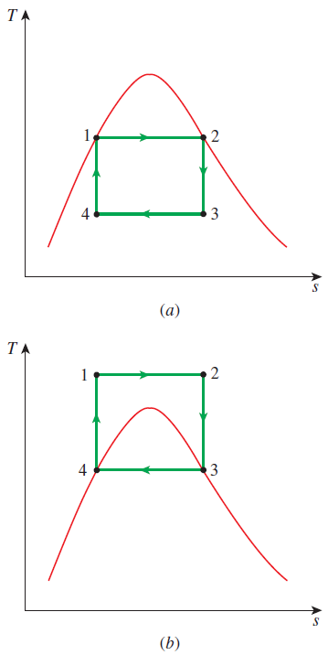
THE CARNOT VAPOR CYCLE
The Carnot cycle is the most efficient cycle operating between two specified temperature limits but it is not a suitable model for power cycles. Because:
Process 1-2 Limiting the heat transfer processes to two-phase systems severely limits the maximum temperature that can be used in the cycle (374°C for water)
Process 2-3 The turbine cannot handle steam with a high moisture content because of the impingement of liquid droplets on the turbine blades causing erosion and wear.
Process 4-1 It is not practical to design a compressor that handles two phases.
The cycle in (b) is not suitable since it requires isentropic compression to extremely high pressures and isothermal heat transfer at variable pressures.
1-2 isothermal heat addition in a boiler
2-3 isentropic expansion in a turbine
3-4 isothermal heat rejection in a condenser
4-1 isentropic compression in a compressor

Slide 4
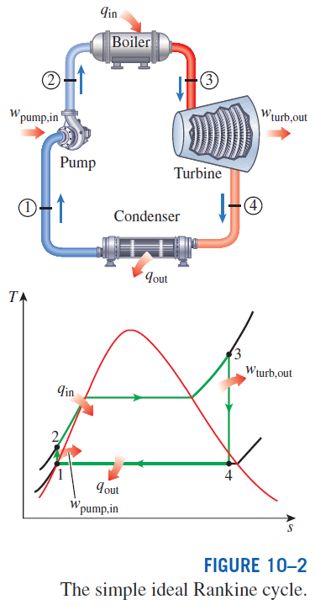
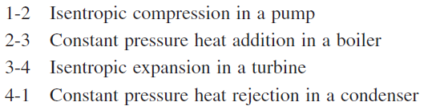
RANKINE CYCLE: THE IDEAL CYCLE FOR VAPOR POWER CYCLES
Many of the impracticalities associated with the Carnot cycle can be eliminated by superheating the steam in the boiler and condensing it completely in the condenser.
The cycle that results is the Rankine cycle, which is the ideal cycle for vapor power plants. The ideal Rankine cycle does not involve any internal irreversibilities.

Slide 5
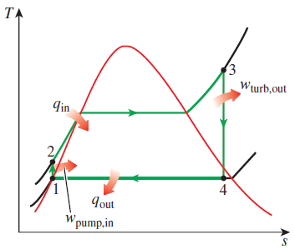


Energy Analysis of the Ideal Rankine Cycle
Steady-flow energy equation
The efficiency of power plants in the U.S. is often expressed in terms of heat rate, which is the amount of heat supplied, in Btu’s, to generate 1 kWh of electricity.
The thermal efficiency can be interpreted as the ratio of the area enclosed by the cycle on a T-s diagram to the area under the heat-addition process.

Slide 6
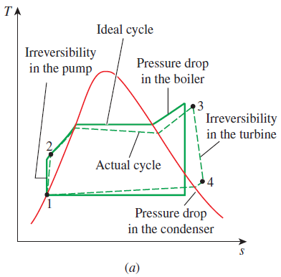
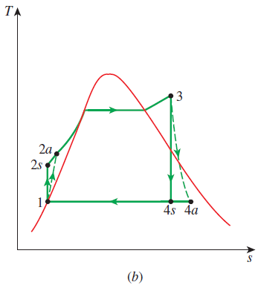
DEVIATION OF ACTUAL VAPOR POWER CYCLES FROM IDEALIZED ONES
The actual vapor power cycle differs from the ideal Rankine cycle as a result of irreversibilities in various components.
Fluid friction and heat loss to the surroundings are the two common sources of irreversibilities.
Isentropic efficiencies
(a) Deviation of actual vapor power cycle from the ideal Rankine cycle. (b) The effect of pump and turbine irreversibilities on the ideal Rankine cycle.

Slide 7
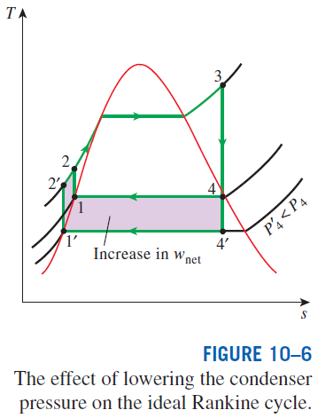
HOW CAN WE INCREASE THE EFFICIENCY OF THE RANKINE CYCLE?
The basic idea behind all the modifications to increase the thermal efficiency
of a power cycle is the same: Increase the average temperature at which heat is transferred to the working fluid in the boiler, or decrease the average temperature at which heat is rejected from the working fluid in the condenser.
Lowering the Condenser Pressure (Lowers T_{low,avg})
To take advantage of the increased efficiencies at low pressures, the condensers of steam power plants usually operate well below the atmospheric pressure. There is a lower limit to this pressure depending on the temperature of the cooling medium
Side effect: Lowering the condenser pressure increases the moisture content of the steam at the final stages of the turbine.

Slide 8
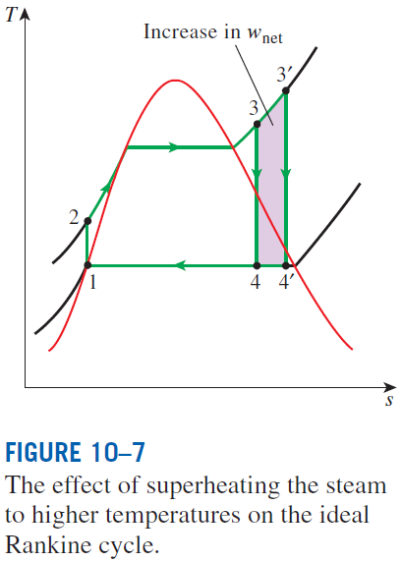
Superheating the Steam to High Temperatures (Increases T_{high,avg})
Both the net work and heat input increase as a result of superheating the steam to a higher temperature. The overall effect is an increase in thermal efficiency since the average temperature at which heat is added increases.
Superheating to higher temperatures decreases the moisture content of the steam at the turbine exit, which is desirable.
The temperature is limited by metallurgical considerations. Presently the highest steam temperature allowed at the turbine inlet is about 620°C.

Slide 9
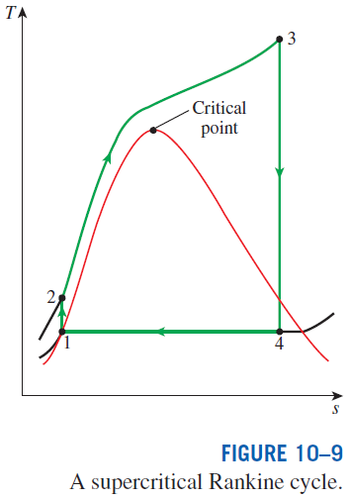
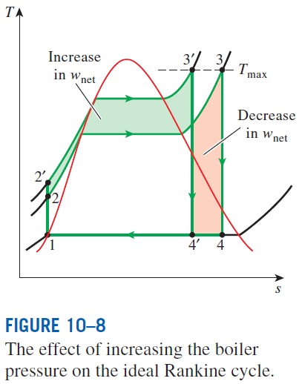
Increasing the Boiler Pressure (Increases T_{high,avg})
Today many modern steam power plants operate at supercritical pressures (P > 22.06 MPa) and have thermal efficiencies of about 40% for fossil-fuel plants and 34% for nuclear plants.
For a fixed turbine inlet temperature, the cycle shifts to the left and the moisture content of steam at the turbine exit increases. This side effect can be corrected by reheating the steam.

Slide 10

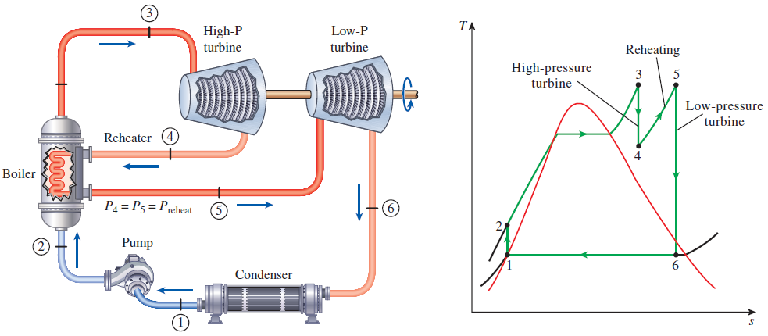
THE IDEAL REHEAT RANKINE CYCLE
How can we take advantage of the increased efficiencies at higher boiler pressures without facing the problem of excessive moisture at the final stages of the turbine?
1. Superheat the steam to very high temperatures. It is limited metallurgically.
2. Expand the steam in the turbine in two stages, and reheat it in between (reheat)

Slide 11
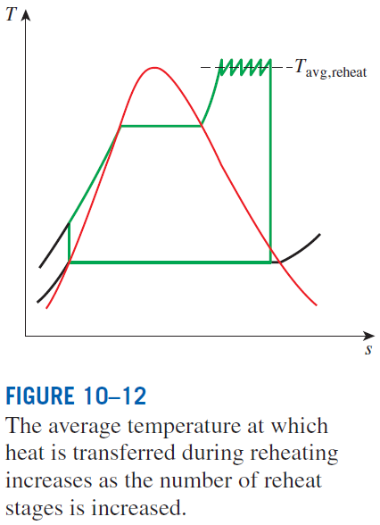
The single reheat in a modern power plant improves the cycle efficiency by 4 to 5% by increasing the average temperature at which heat is transferred to the steam.
The average temperature during the reheat process can be increased by increasing the number of expansion and reheat stages. As the number of stages is increased, the expansion and reheat processes approach an isothermal process at the maximum temperature. The use of more than two reheat stages is not practical. The theoretical improvement in efficiency from the second reheat is about half of that which results from a single reheat.
The reheat temperatures are very close or equal to the turbine inlet temperature.
The optimum reheat pressure is about one-fourth of the maximum cycle pressure.

Slide 12
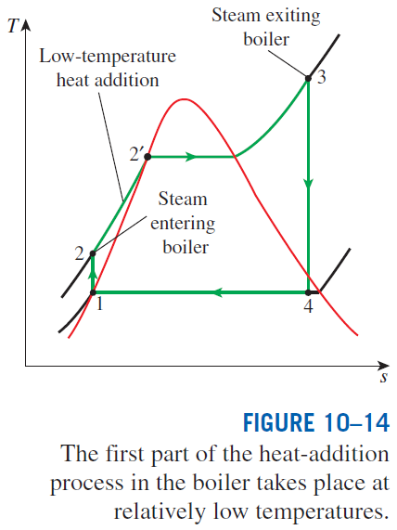
THE IDEAL REGENERATIVE RANKINE CYCLE
Heat is transferred to the working fluid during process 2-2 at a relatively low temperature. This lowers the average heat-addition temperature and thus the cycle efficiency.
In steam power plants, steam is extracted from the turbine at various points. This steam, which could have produced more work by expanding further in the turbine, is used to heat the feedwater instead. The device where the feedwater is heated by regeneration is called a regenerator, or a feedwater heater (FWH).
A feedwater heater is basically a heat exchanger where heat is transferred from the steam to the feedwater either by mixing the two fluid streams (open feedwater heaters) or without mixing them (closed feedwater heaters).

Slide 13
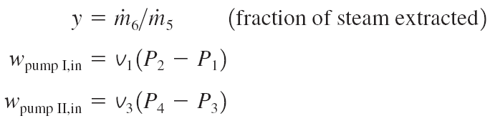
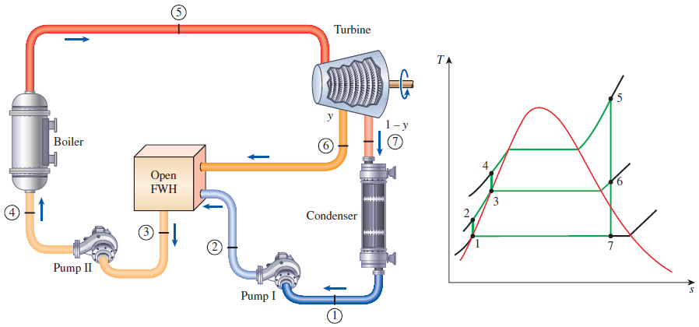
Open Feedwater Heaters
An open (or direct-contact) feedwater heater is basically a mixing chamber, where the steam extracted from the turbine mixes with the feedwater exiting the pump. Ideally, the mixture leaves the heater as a saturated liquid at the heater pressure.
The ideal regenerative Rankine cycle with an open feedwater heater.

Slide 14
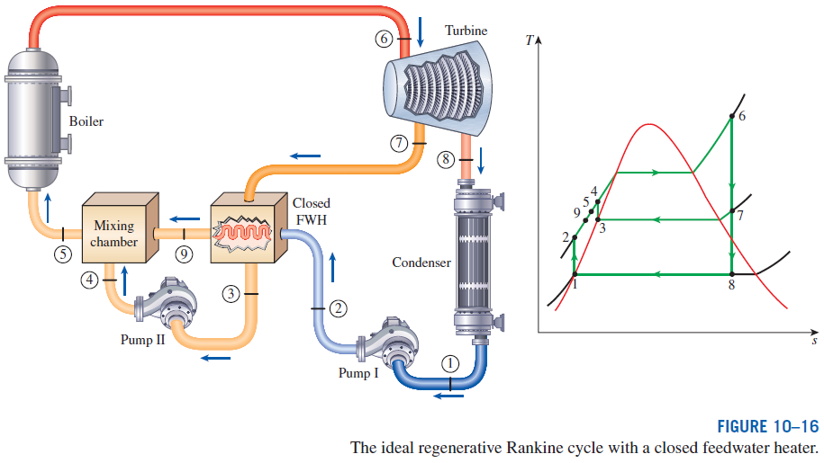
Closed Feedwater Heaters
Another type of feedwater heater frequently used in steam power plants is
the closed feedwater heater, in which heat is transferred from the extracted steam to the feedwater without any mixing taking place. The two streams now can be at different pressures, since they do not mix.

Slide 15
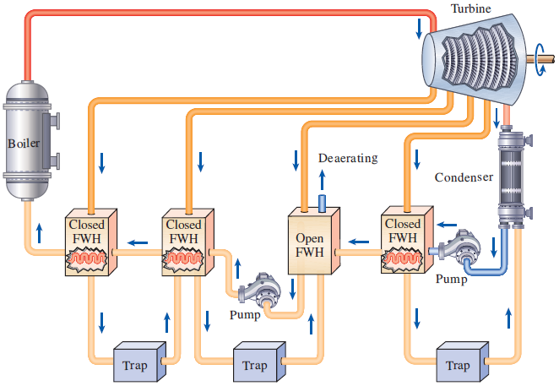
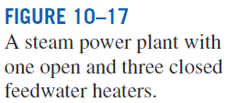
The closed feedwater heaters are more complex because of the internal tubing network, and thus they are more expensive. Heat transfer in closed feedwater heaters is less effective since the two streams are not allowed to be in direct contact. However, closed feedwater heaters do not require a separate pump for each heater since the extracted steam and the feedwater can be at different pressures.
Open feedwater heaters are simple and inexpensive and have good heat transfer characteristics. For each heater, however, a pump is required to handle the feedwater.
Most steam power plants use a combination of open and closed feedwater heaters.

Slide 16
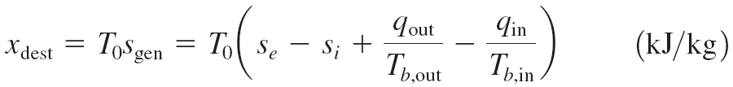
SECOND-LAW ANALYSIS OF VAPOR POWER CYCLES
Exergy destruction for a steady-flow system
Steady-flow, one-inlet, one-exit
Exergy destruction of a cycle
For a cycle with heat transfer only with a source and a sink
Stream exergy
A second-law analysis of vaporpower cycles reveals where the largest irreversibilities occur and where to start improvements.

Slide 17
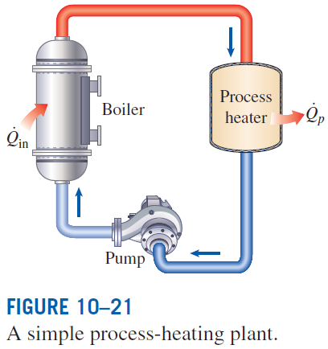
COGENERATION
Many industries require energy input in the form of heat, called process heat. Process heat in these industries is usually supplied by steam at 5 to 7 atm and 150 to 200°C. Energy is usually transferred to the steam by burning coal, oil, natural gas, or another fuel in a furnace.
Industries that use large amounts of process heat also consume a large amount of electric power.
It makes sense to use the already-existing work potential to produce power instead of letting it go to waste.
The result is a plant that produces electricity while meeting the process-heat requirements of certain industrial processes (cogeneration plant)
Cogeneration: The production of more than one useful form of energy (such as process heat and electric power) from the same energy source.

Slide 18

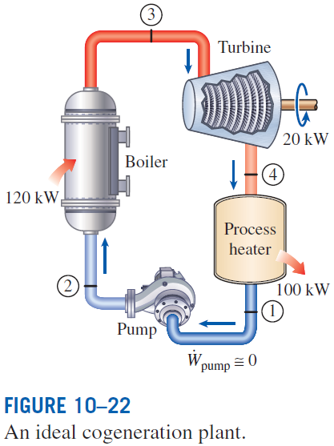

Utilization factor
The utilization factor of the ideal steam-turbine cogeneration plant is 100%.
Actual cogeneration plants have utilization factors as high as 80%.
Some recent cogeneration plants have even higher utilization factors.

Slide 19
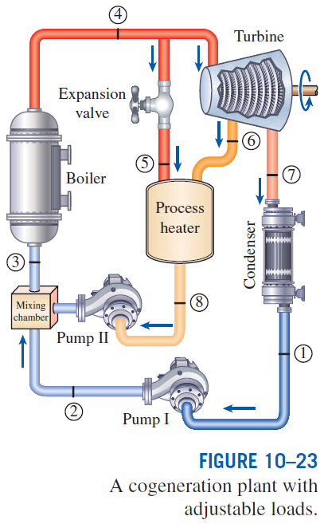
At times of high demand for process heat, all the steam is routed to the process-heating units and none to the condenser (m₇= 0). The waste heat is zero in this mode.
If this is not sufficient, some steam leaving the boiler is throttled by an expansion or pressure-reducing valve to the extraction pressure P₆ and is directed to the process-heating unit.
Maximum process heating is realized when all the steam leaving the boiler passes through the PRV (m₅= m₄). No power is produced in this mode.
When there is no demand for process heat, all the steam passes through the turbine and the condenser (m₅=m₆=0), and the cogeneration plant operates as an ordinary steam power plant.

Slide 20
COMBINED GAS–VAPOR POWER CYCLES
The continued quest for higher thermal efficiencies has resulted in rather innovative modifications to conventional power plants.
A popular modification involves a gas power cycle topping a vapor power cycle, which is called the combined gas–vapor cycle, or just the combined cycle.
The combined cycle of greatest interest is the gas-turbine (Brayton) cycle topping a steam-turbine (Rankine) cycle, which has a higher thermal efficiency than either of the cycles executed individually.
It makes engineering sense to take advantage of the very desirable characteristics of the gas-turbine cycle at high temperatures and to use the high-temperature exhaust gases as the energy source for the bottoming cycle such as a steam power cycle. The result is a combined gas–steam cycle.
Recent developments in gas-turbine technology have made the combined gas–steam cycle economically very attractive.
The combined cycle increases the efficiency without increasing the initial cost greatly. Consequently, many new power plants operate on combined cycles, and many more existing steam- or gas-turbine plants are being converted to combined-cycle power plants.
Thermal efficiencies over 50% are reported.

Slide 21
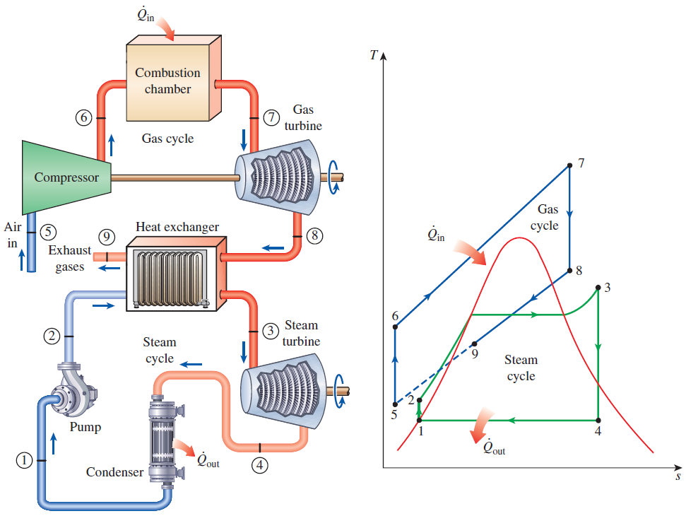


Slide 22
Summary
The Carnot vapor cycle
Rankine cycle: The ideal cycle for vapor power cycles
Energy analysis of the ideal Rankine cycle
Deviation of actual vapor power cycles from idealized ones
How can we increase the efficiency of the Rankine cycle?
Lowering the condenser pressure (Lowers T_{low,avg})
Superheating the steam to high temperatures (Increases T_{high,avg})
Increasing the boiler pressure (Increases T_{high,avg})
The ideal reheat Rankine cycle
The ideal regenerative Rankine cycle
Open feedwater heaters
Closed feedwater heaters
Second-law analysis of vapor power cycles
Cogeneration
Combined gas–vapor power cycles

